Slide 1


Smart Traffic Violation Management System
OOP Lab Project · BSCS 2A
INSTRUCTOR: MAM ZOOBIA FATIMA
Presented By: Adnan Nasir (Group Lead) · Mohid Tanveer · Meekal Raees · Maaz Munawwar

Slide 2


Introduction
Traffic rule violations are a leading cause of road accidents and urban traffic mismanagement. This project addresses that challenge by building an automated, object-oriented system in C++ that manages the entire violation lifecycle — from detection to challan generation.
Manage Violations
Record and track all traffic infractions
Store Details
Driver and vehicle data management
Auto-Detect
Automatic violation detection logic
Generate Challan
Calculate fines and issue receipts

Slide 3





Project Objectives
The system is designed with clear, measurable goals to modernize how traffic violations are handled in a digital environment.
Track Violations
Maintain a complete log of traffic infractions
Manage Records
Store driver and vehicle information securely
Calculate Penalties
Automatically compute fines based on violation type
Digital Challans
Generate and print challan receipts instantly

Slide 4

Problem Statement
Traditional traffic fine systems rely heavily on manual processes, creating inefficiencies that affect both enforcement officers and citizens alike.
Manual Paperwork
Physical forms are slow, error-prone, and difficult to scale
Data Loss Risk
Paper records are vulnerable to damage, loss, and misplacement
Slow Fine Calculation
Manual computation leads to delays and potential miscalculations
Poor Record Management
No centralized system to search, sort, or retrieve violation history
Our Solution: Automating the entire process eliminates these inefficiencies through structured OOP design in C++.

Slide 5




OOP Concepts Implemented
The system is built on four core Object-Oriented Programming principles, each playing a distinct role in the architecture.
Encapsulation
Private and public members within classes protect data integrity and control access to sensitive information.
Inheritance
The Challan class inherits from Driver, Vehicle, and Violation, promoting code reuse.
Abstraction
Complex operations are hidden behind clean function interfaces, simplifying interaction for the user.
Modularity
Separate classes handle distinct functionalities, making the system easy to maintain and extend.

Slide 6
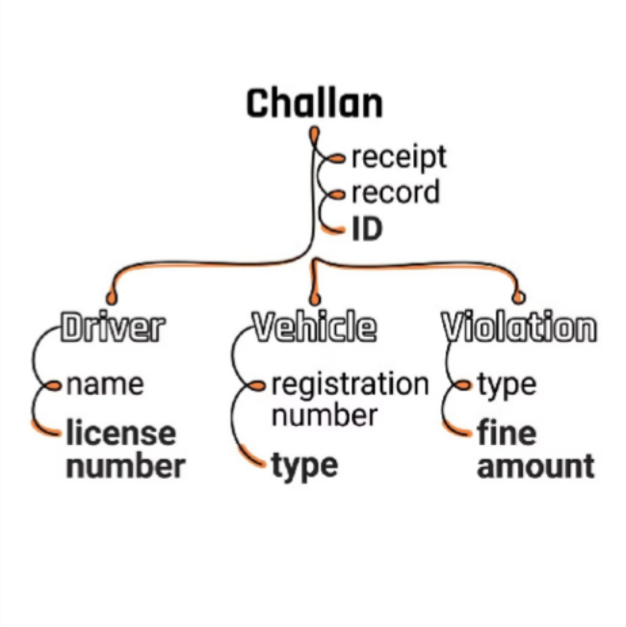
Classes & Their Purpose
Four core classes form the backbone of the system, each responsible for a specific domain of data and behavior.
1
2
3
4
Driver
Stores driver name and license number
Vehicle
Stores vehicle registration number and type
Violation
Stores violation type and corresponding fine amount
Challan
Generates Challan ID, receipt, and full violation record

Slide 7
Supported Violations & Fines
The system handles five common traffic violations, each mapped to a predefined fine amount calculated automatically at runtime.
Violation Type | Fine Amount
Signal Break (Both Vehicles) | Rs. 1,000
Over Speeding ( Car Drivers) | Rs. 3,000
No Helmet (For Bikers) | Rs. 1,500
Illegal Parking (For Car Drivers) | Rs. 2,000
No Seat Belt ( For Car Drivers) | Rs. 2,500
Fine amounts are stored within the Violation class and accessed via encapsulated getter methods.

Slide 8

System Workflow
Enter Challan ID
Vehicle Details
Violation Type
Driver Details
Calculate Fine
The workflow guides the user through a linear, step-by-step process. Each stage collects the necessary data before proceeding, ensuring data completeness before the challan is generated. The final output includes driver data, vehicle details, fine amount, and payment status — all displayed in a structured, centered console interface.

Slide 9

Program Output Features
Interface Display
The system uses centerText() to align all content in the center for a clean console interface, while ASCII art is used to display traffic visuals like a police officer, road, and car.
Formatted challan receipts and organized text layout
i_{C}m_{h}pr_{a}o_{l}v_{l}e_{an R}o_{e}ve_{c}r_{e}al_{i}l_{pt C}i_{o}nt_{n}e_{t}r_{a}fa_{i}c_{n}e_{s}and
centerText() to all
clean interface, while art
center
used to display and car.
traffic visuals like a officer,
Formatted challan receipts and organized text layout improve the interface readability.
Challan ID & Driver Name
License Number & Vehicle Number
Violation Type & Fine Amount
Payment Status

Slide 10

Conclusion & Future Roadmap
The Smart Traffic Violation Management System successfully demonstrates how OOP principles in C++ can solve real-world problems — reducing manual effort, improving accuracy, and digitizing challan generation.
o Achieved Automated fine calculation, digital challans, structured record management
🔜 File Handling Persist records across sessions using file I/O
🔜 Database Integrate a database for scalable data storage
🔜 Admin & Payment Add login authentication and online payment gateway
THANK YOU
BSCS 2A · OOP LAB

